Slide 1
Ten Things You Can Do in Ten Minutes With the netFORUM Toolkit
10 netFORUM Enterprise Developers
May 7, 2018

Slide 2

Password Vault: HaveIBeenPwned.com Integration
Rich Hem
Managing Director, IT
American Institute of Aeronautics and Astronautics

Slide 3
Goal
Help customers create ‘good’ eWeb passwords
Credential reuse is common
Over half a BILLION breached credential pairs available on the Internet
netFORUM password hashes are salted/padded …. but
NIST now recommends user-provided passwords be checked against existing data breaches

Slide 4
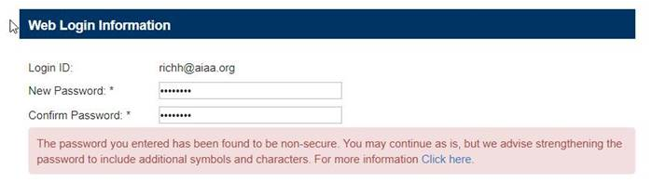
netFORUM Password Vault Experience
When eWeb customer creates or changes their password, it is checked against haveibeenpwned.com api
If not in the database, customer not aware this happened
If is the database, (customizable) warning message is returned:

Slide 5
Technical Overview
Js-haveibeenpwned commissioned by AIAA and created by Gravitate Solutions
Requires js-sha1 library
Created in JavaScript instead of C# for portability
AIAA giving solution to netFORUM community via MIT license.
https://github.com/richhem-aiaa/Netforum-Password-Vault

Slide 6
js-haveibeenpwned.js
Creates SHA-1 hash of password
Sends the first 5 characters of the hash (not case-sensitive) to the haveibeenpwned.com api
If the first 5 characters is found, the API will responds with http 200 and include the suffix of every hash beginning with the specified prefix, and a count of how many times it appears in the data set.
The js will then search the results of the response for the presence of their source hash

Slide 7
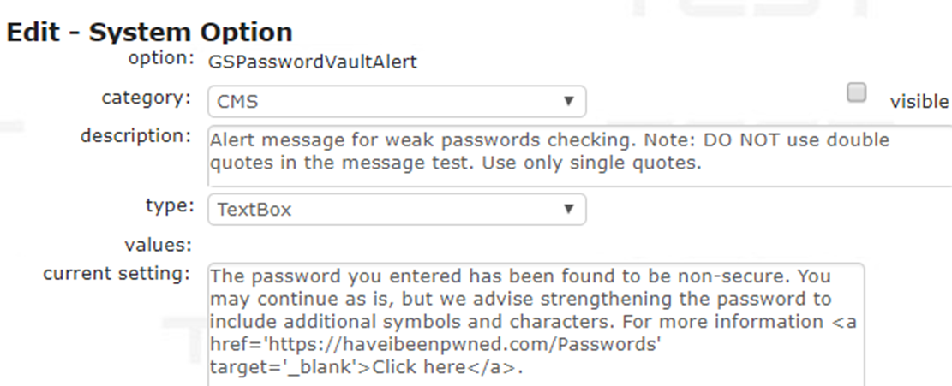
Using this with netFORUM
Every netFORUM instance is unique … so
AIAA uses this with eWeb createaccount, passwordreset, changepassword
Created a System Option for customizable warning message, e.g.:

Slide 8

Using this with netFORUM - AIAA
Created a bundle that combined the sha1 and HIBP libraries and AIAA the page-specific implementation code
https://netforum.aiaa.org/eWeb/Scripts/haveibeenpwned-bundle.js
Then add this to eWeb page:

Slide 9
Credit
Many thanks to Jason Watts at Gravitate Solutions for developing the JavaScript and documentation for the solution
Thanks to AIAA management (aka my boss) for allowing this to be shared with the netFORUM community

